Slide 1
Support Vector Machines

Slide 2
Support Vector Machines (SVMs)
Originated in 1979 by a paper By Vladimir Vapnik
The major development were invented mostly in the 1990’s
Its roots are in linear classification
  But it has non-linear extensions
It has a very elegant (though very difficult) mathematical background
  The learning problem will be solved by quadratic optimization, which will lead to a globally optimal solution
It has been successfully applied to a lot of machine learning problems in the last 20 years
It was the most successful and most popular machine learning algorithm in the 90’s

Slide 3
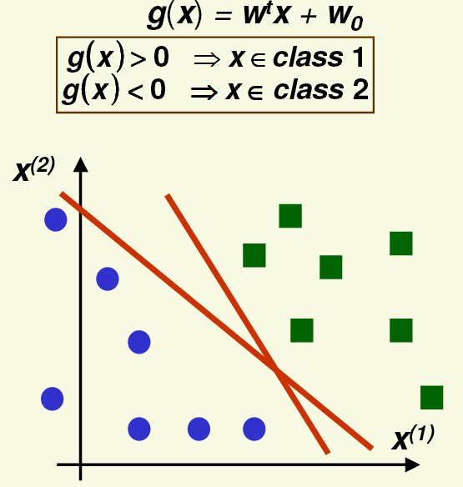
Let’s return to linear discriminant functions
In the linearly separable case
usually there are a lot of possible
solutions
Which one should we prefer
from among the red lines?

Slide 4
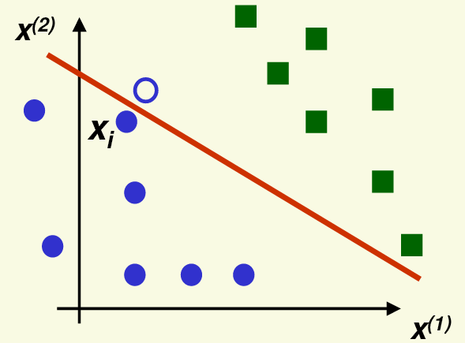
Linear discriminant functions
Remember that the training data items are just samples from all the possible data
Our goal is to generalize to
unseen data
A new sample from a class is
likely to be close to the training
samples from the same class
So if the decision boundary is
close to the training samples,
then the new sample will fall on
the wrong side → misclassification
Our heuristic here will be that putting the decision boundary as far from the samples as possible will hopefully increase generalization

Slide 5
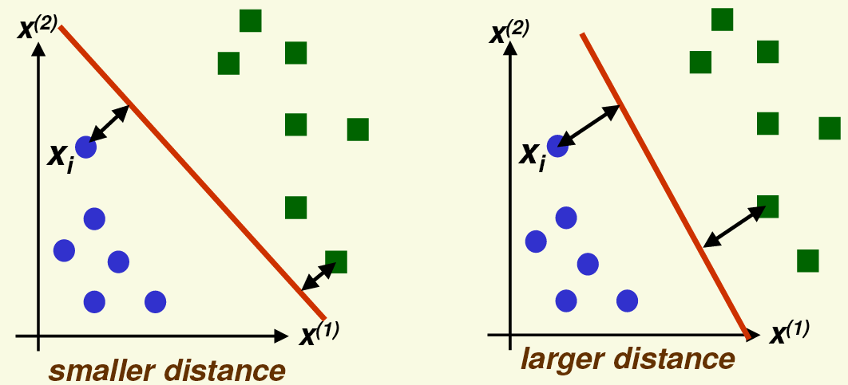
Support Vector Machines – Basic Idea
Our basic ideas will be to move the hyperplane as fas as possible from the training data
For the optimal hyperplane the distance from the nearest example from class 1 will be the same as the distance from the nearest example from class 2

Slide 6
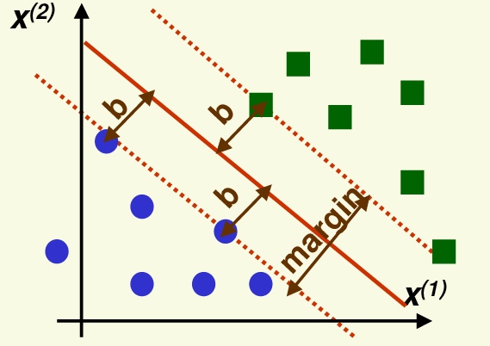
SVMs – Linearly Separable Case
SVMs will seek to maximize the margin
Where the margin is twice the distance of the closest example to the separating hyperplane
Maximizing the margin leads to a better generalization
  Both is theory and in practice

Slide 7
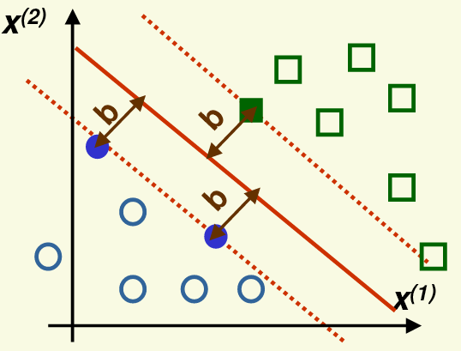
SVMs – Linearly Separable Case
The support vectors are the samples that are the closest to the separa-ting hyperplane
These samples are the most difficult to classify
The separating hyperplane is completely defined by the support vectors
  But of course, we will know which samples are the support vectors only after finding the optimal hyperplane

Slide 8
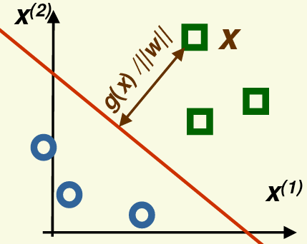
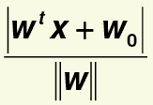
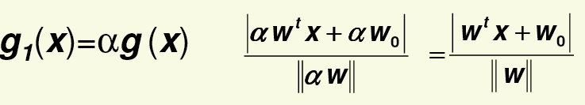

Formalizing the margin
Remember that the distance of any x point from the separating hyperplane where g(x)=0 can be calculated as
And the distance remains the same if we
multiply g(x) by a non-zero constant:
This means that minimizing the margin does not uniquely define g(x)
To make the largest margin hyperplane unique, we also require
for any support vector x_{i}

Slide 9
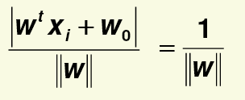
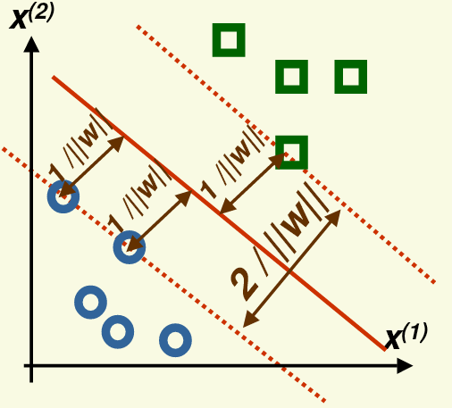
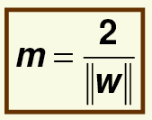
Formalizing the margin
With this restriction for all the support vectors
And the size of the margin is:

Slide 10
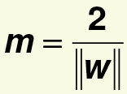


Maximizing the margin
We want to maximize the margin
So that all the samples are correctly classified
and fall outside the margin:
Similar to the normalization step for linear
classifiers, we want multiply the inequalities
for the negative class by -1
For this, we introduce the variable z:

Slide 11


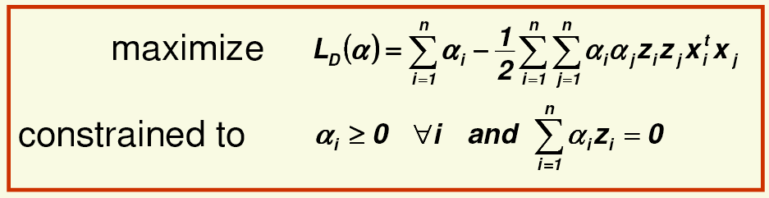
Maximizing the margin
We will maximize the margin by minimizing its reciprocal
with the constraint:
J(w) is a quadratic function, so it has a single global minimum
The optimization should be solved with satisfying linear constraints
This altogether leads to a quadratic programming task
According to the Kuhn-Tucker theorem, the problem is equivalent to
Where α_{i} are new variables (one for each example)

Slide 12
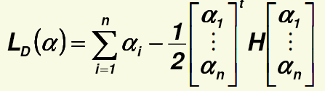


Maximizing the margin
L_{D}(α) can also be written as
Where H is an nxn matrix with
L_{D}(α) can be optimized by quadratic programming
Let’s suppose we found the optimal α=(α₁,…, α_{n})
Then for each training sample either α_{i}=0
or α_{i}≠0 and
The samples for which α_{i}≠0 will be the support vectors!

Slide 13


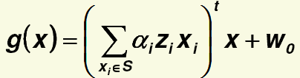
Maximizing the margin
We can calculate w as
And we can obtain w₀ by taking any support vector x_{i} for which α_{i}>0:
The final discriminant function will be given as
  Where S is the set of support vectors
Notice that the discriminant function depends only on the support vectors, and it is independent of all the other training samples!
  Unfortunately, the number of support vectors usually increases linearly with the number of training samples
Training SVMs is slow: requires operations with the nxn matrix H
  A lot of efforts have been made to reduce the training time of SVMs

Slide 14
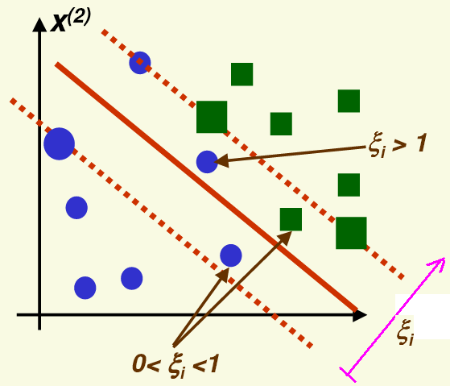


SVMs – linearly non-separable case
Most real-life tasks are linearly non-separable – can we still apply SVMs in this case?
Yes, but will have to allow samples to fall on the wrong side
  And punish these samples during optimization
For this we introduce the variables ξ₁,…, ξ_{n}
(one for each training sample)
  ξ₁ depends on the distance of x_{i} from the margin
  We use ξ=0 for samples that on the
  right side, and also outside the margin
  0<ξ₁<1 means mean that the sample is on the
  right side, but within the margin
  ξ>1 means that the sample is on the wrong side
We change the constraints from to
(“soft margin”)

Slide 15

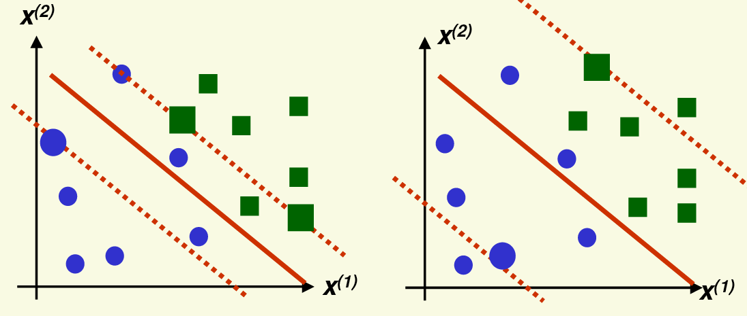
SVMs – linearly non-separable case
We extend the target function to be minimized as
Where C is a parameter which allows to tune the importance of the newly introduced “punishment term”
  Larger C allows fewer samples to be in a suboptimal position
  Smaller C allows more samples to be in a suboptimal position

Slide 16
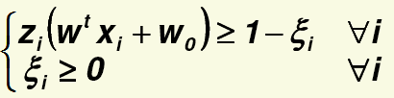
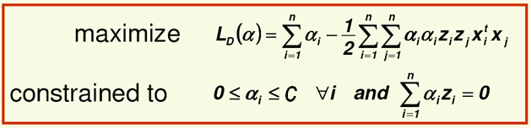
SVMs – linearly non-separable case
So we have to minimize
With the constraints
The Kuhn-Tucker theorem turns this into the quadratic programming problem
And the solution can be obtained very similarly to the separable case
  Only the constraints have been modified

Slide 17
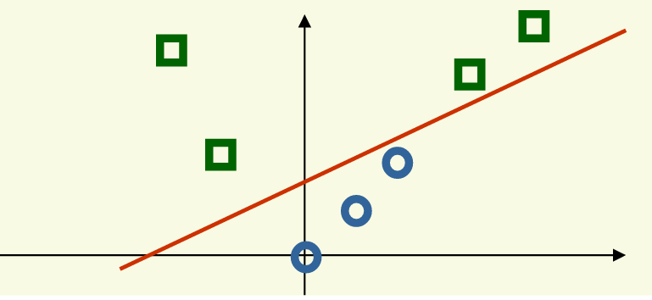
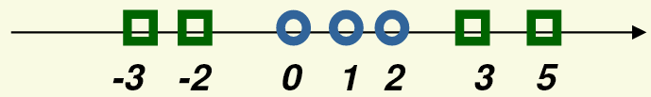
Non-linear SVMs
The linear SVM still uses a linear discriminant function
It is not flexible enough to solve real-life problems
We will create a non-linear extension of the SVM method by (non-linearly) projecting the training data into a larger dimensional space
Cover’s theorem: a pattern-classification problem cast in a high dimensional space non-linearly is more likely to be linearly separable than in a low-dimensional space
Example:
1D task, linearly non-separable → 2D task, linearly separable
Where the features for newly introduced dimension are obtained as x²

Slide 18
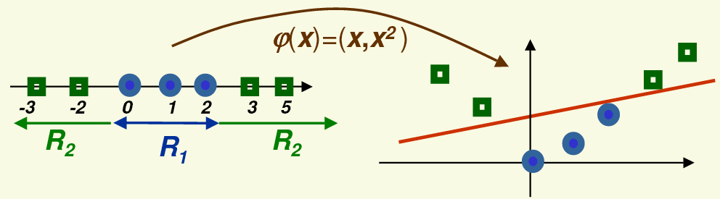


Non-linear SVMs
We will denote the function that project the data into the new feature space by φ(x)
The steps of non-linear classification will be:
  Project the data points into the new feature space using φ(x)
  Find the linear discriminant function in this new feature space
  Project the discriminant function back to the original space, where it won’t be linear:

Slide 19
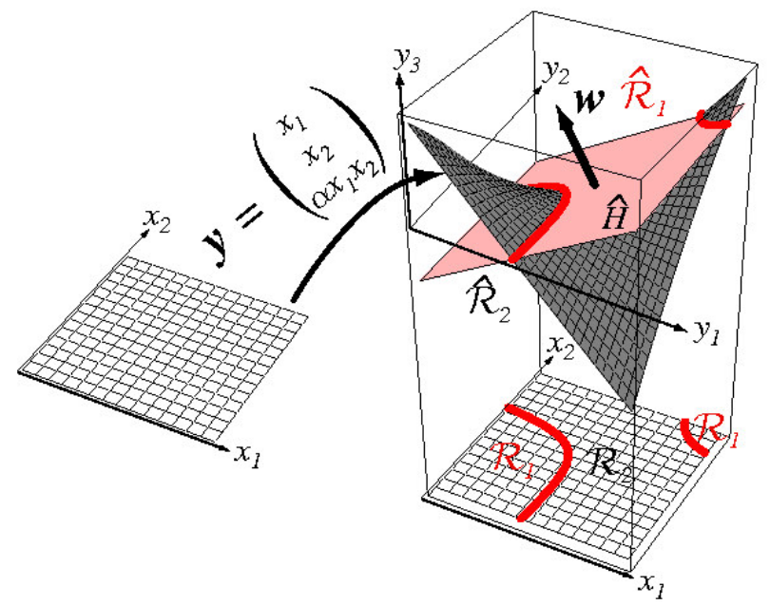
Another example for feature space projection

Slide 20
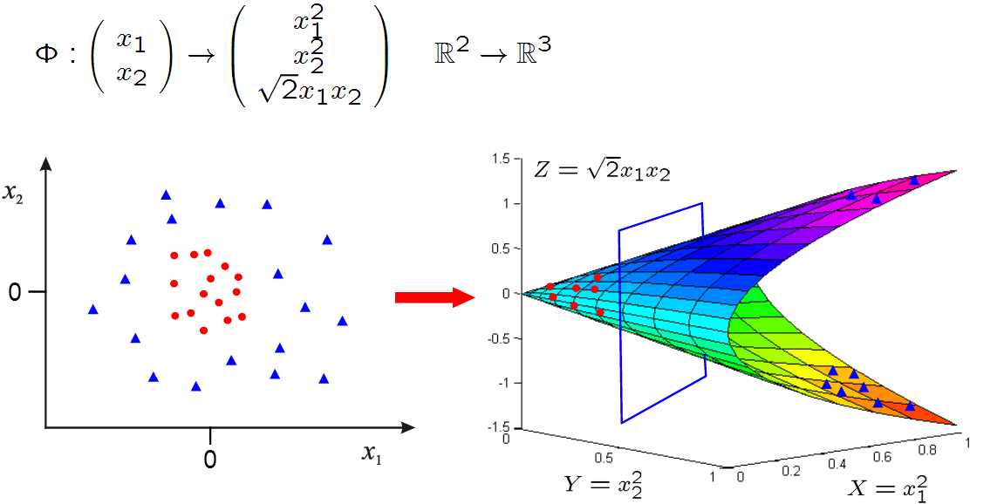
Yet another example
The data is not linearly separable in the original 2D space, but it becomes linearly separable in the projected 3D space

Slide 21
Classifying in higher dimension
Projecting the data into a higher dimensional space makes the classes linearly separable
But what are the risks of working in a higher dimensional space?
  The risk of overfitting increases (remember the “curse of dimensionality”!)
  The computational complexity increases
Fortunately, the SVM training algorithm is quite insensitive to the number of dimensions
  It can be shown that the generalization capability of an SVM depends on the margin found, and not on the number of dimensions
Computation in the higher dimensional space can be performed implicitly by the use of kernel functions
  This will allow us even to work in an infinite-dimensional space!

Slide 22


The “kernel trick”
Remember that our function to be maximized was formulated as
It does not require the training vectors directly, only their pairwise inner products x_{i}^{t}x_{j}
If we project the samples into a higher dimensional space by using φ(x) instead of x, then The above formula will require φ(x_{i}^{t})φ(x_{j})
We would like to avoid the computation of these inner products directly, as these vector have a high dimension
The solution (“Kernel trick”): we find a kernel function K(x_{i},x_{j}) for which
This way, instead of calculating φ(x_{i}^{t}) and φ(x_{j}) and then taking their inner product, we will have to calculate only K(x_{i},x_{j}), which is in the original lower-dimensional space!

Slide 23

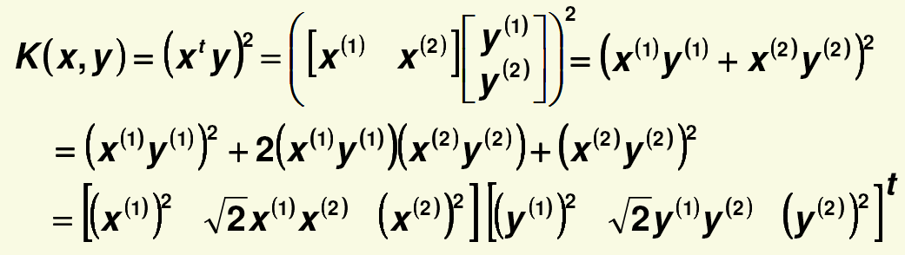

Kernel functions
Of course, not all possible K(x_{i},x_{j}) functions will correspond to an inner product φ(x_{i}^{t})φ(x_{j}) in a higher dimensional space
  So we cannot just randomly select any K(x_{i},x_{j}) function
The Mercer condition tells us which K(x_{i},x_{j}) function in the original space can be expressed as a dot product in another space
Example: Suppose we have only two features
And the kernel function will be
We show that it can be written as an inner product:
We managed to write K(x, y) as an inner product with

Slide 24


Kernel functions in practice
As kernel functions are hard to find, in practice we usually apply some standard, well-known kernel functions
The popular kernel functions:
  Polinomial kernel:
  Gaussian or radial basis function (RBF) kernel (corresponds to a projection into infinite-dimensional space!):
For a huge list of possible kernel functions, see:
  http://crsouza.com/2010/03/17/kernel-functions-for-machine-learning-applications/
Unfortunately, in practice it is very difficult to tell which kernel function will work well for a given machine learning task ☹

Slide 25



The discriminant function
SVM finds a linear discriminant function in the high-dimensional space:
How will it look like in the original space?
Let’s examine only the case when the first component of φ(x) is 1, eg:
In this case wφ(x) will already contain a component which is independent of x. As it will play the role of w₀, we can restrict ourselves to discriminant functions that have the form

Slide 26



The discriminant function
Remember that the linear SVM maximizes
If we project our data into a higher dimensional space using φ(x), than the problem turns into
For the linear case we obtained the weight vector as
Now it becomes

Slide 27
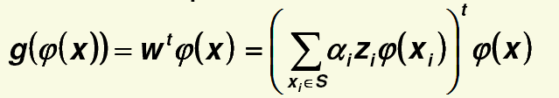
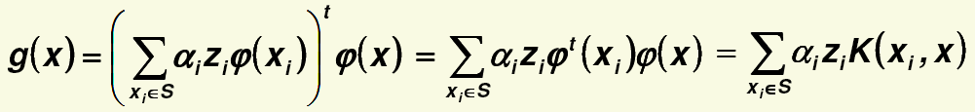
The discriminant function
The discriminant function in the high dimensional space is linear
The discriminant function in the original space is:
Which will be non-linear is the kernel function is non-linear

Slide 28
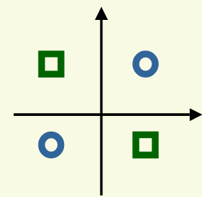

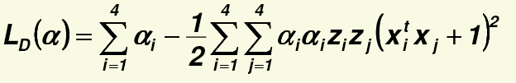

Example – The XOR problem
The classification task is to separate two classes with 2-2 samples:
  Class 1: x1=[1,-1] x2=[-1,1]
  Class 2: x3=[1,1] x4=[-1,-1]
This is the simplest task in 2D which is
linearly non-separable
We will apply the kernel function
Which corresponds to the mapping
And we have to maximize
With the constraints

Slide 29

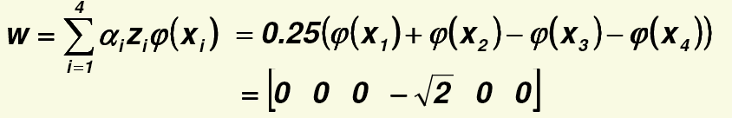

Example – The XOR problem
The solution is α₁= α₂= α₃= α₄=0.25
  Which also means that all the 4 samples are support vectors
Remember that the transformed feature space has 6 dimensions calculated as
So the weight vector of the linear discriminant in this space has 6 components:
  Which has only 1 non-zero component
The discriminant function in the original feature space is:

Slide 30
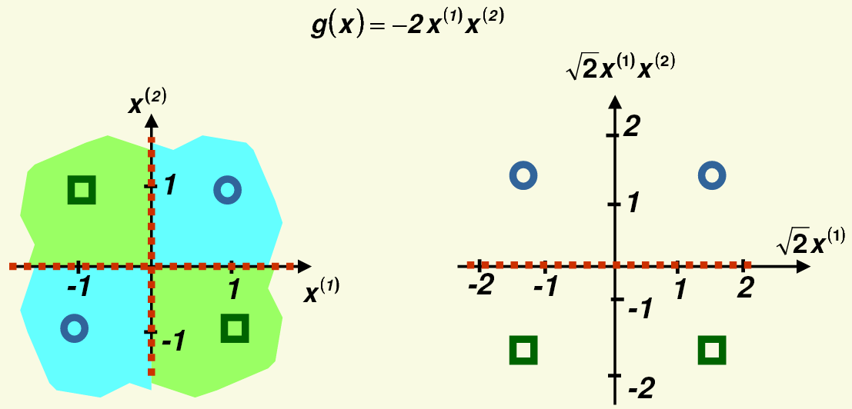
Example – The XOR problem
The decision boundary where g(x)=0
It is non-linear in the original 2Dfeature space, while it is linear in the new 6D feature space (from which only 2 dimensions are shown in the figure), and it also correctly separates the two classes

Slide 31
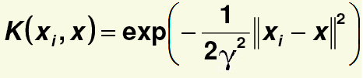
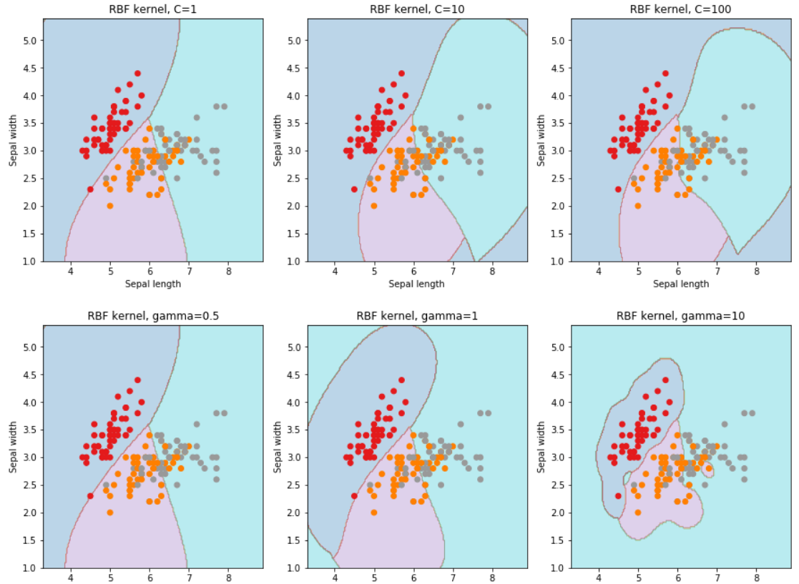
Example – RBF kernel
The kernel function is
  You can see how the decision boundaries change with the meta-parameters C (it is the parameter of SVM) and gamma (it is the parameter of the kernel function)

Slide 32
SVM extensions
Multi-class classification:
  It is not easy to extend SVMs to multi-class classification
  As the simplest solution, one can use the “one against the rest” or the “one against one” method presented earlier
Probability estimation
  The SVM outputs cannot be directly interpreted as posterior probability estimates. There exists several solutions to convert their outputs to probability estimates, but these are just approximations
Regression
  SVMs have several extensions which allow them to solve regression tasks instead of classification

Slide 33
SVM - Summary
Advantages:
  It is based on a nice theory
  It has good generalization properties (not inclined to overfitting)
  It is guaranteed to find the global optimum
  With the “kernel trick” it is able to find non-linear discriminant functions
  The complexity of the learned classifier depends on the number of support vectors found, not on the number of training samples, nor on the number of dimensions of the transformed space
Disadvantages
  The quadratic programming optimization is computationally more expensive than most of the other machine learning methods
  Chosing the optimal kernel function is difficult

